Slide 1


CMR TECHNICAL CAMPUS
UGC AUTONOMOUS
Accredited by NBA & NAAC with ‘A’ Grade
Approved by AICTE,New Delhi and affiliated to JNTU,Hyderabad Kandlakoya (V), Medchal Road, Hyderabad -501401, Telangana
Department of Computer Science and Engineering
Major Project Review
INTERNET FINANCIAL FRAUD BASED ON A DISTRIBUTED BIG DATA APPROACH WITH NODE2VEC
BATCH NO-23
UNDER THE GUIDENCE OF :
Dr. J. NARASIMHARAO
(Associate Professor)
PRESENTED BY:
T.YASHWANTH : 207R1A05P2
T.M.DEEKSHIT : 207R1A05P1
S.NARENDER : 207R1A05P0

Slide 2
CONTENTS
ABSTRACT
EXISTING SYSTEM
DISADVANTAGES OF EXISTING SYSTEM
PROPOSED SYSTEM
ADVANTAGES OF PROPOSED SYSTEM
HARDWARE REQUIREMENTS & SOFTWARE REQUIREMENTS
NOVELTY OF PROJECT
ARCHITECTURE
MODULES
UML DIAGRAMS
CONCLUSION

Slide 3

ABSTRACT
The rapid development of information technologies like Internet of Things, Big Data, Artificial Intelligence, etc., has profoundly affected people's consumption behaviors and changed the development model of the financial industry. The financial services on Internet and IoT with new technologies has provided convenience and efficiency for consumers, but new hidden fraud risks are generated also. Fraud, arbitrage, vicious collection, etc., have caused bad effects and huge losses to the development of finance on Internet and IoT.

Slide 4

EXISTING SYSTEM
The existing systems for internet financial fraud detection often face challenges in scalability and efficiency. They struggle to handle the massive volume of financial data generated from various online transactions. Traditional methods may not effectively capture the intricate patterns and anomalies indicative of fraudulent activities. These project involves identifying the current processes related to financial fraud detection, analyzing the characteristics of financial data, and assessing data sources and quality.

Slide 5

DISADVANTAGES OF EXISTING SYSTEM
The system doesn’t support Resilient Distributed Datasets.
There is no Directed Acyclic Graph method to find fraud accurately.

Slide 6
PROPOSED SYSTEM
Utilizing distributed computing frameworks such as Apache Spark or Hadoop to process large volumes of financial data efficiently.
Employing Node2Vec algorithm to learn distributed representations of nodes in the transaction graph, capturing intricate patterns indicative of fraudulent activities.
Integrating advanced machine learning techniques for anomaly detection and fraud prediction.
Implementing real-time monitoring and alerting mechanisms to promptly identify suspicious transactions.

Slide 7

ADVANTAGES OF PROPOSED SYSTEM
Node2Vec is a graph embedding algorithm that introduces two biased random walk methods---BFS (Breadth First Search) and DFS (Depth First Search) on the basis of Deep Walk.
AN INTELLIGENT AND DISTRIBUTED BIG DATA APPROACH FOR INTERNET FINANCIAL FRAUD DETECTION.
Reduced false positive rates: By incorporating advanced machine learning techniques, the system can minimize false alerts, thereby improving resource utilization and operational efficiency.

Slide 8
HARDWARE REQUIREMENTS
The following are some hardware requirements.
Processor - Pentium –IV
RAM - 4 GB (min)
Hard Disk - 20 GB
Keyboard - Standard Windows Keyboard
Mouse - Two or Three Button Mouse
Monitor - SVGA

Slide 9
SOFTWARE REQUIREMENTS
The following are some software requirements.
Operating system : Windows 7 Ultimate.
Coding Language : Python.
Front-End : Python.
Back-End : Django-ORM
Designing : Html, CSS, JavaScript.
Data Base : MySQL (WAMP Server).

Slide 10
NOVELTY OF THE PROJECT
The novelty of our project lies in the synergistic combination of distributed big data processing, graph analytics, advanced machine learning, and real-time monitoring capabilities for internet financial fraud detection. By harnessing the power of these technologies, we aim to develop a robust and scalable solution that can effectively combat fraud in today's increasingly interconnected and digital financial ecosystem.

Slide 11
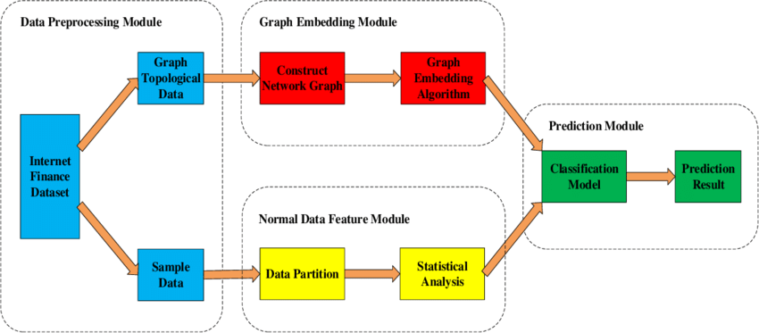
ARCHITECTURE

Slide 12
MODULES
SERVICE PROVIDER
REMOTE USER
Browse Tweets Data Sets and Train & Test
View Trained and Tested Accuracy in Bar Chart
View Trained and Tested Accuracy Results
View Prediction Of Financial Type
View Financial Classify Type Ratio
Download Financial Type Predicted Data Sets
View Financial Type Ratio Results
View All Remote Users
Predict financial datatype
View your profile

Slide 13
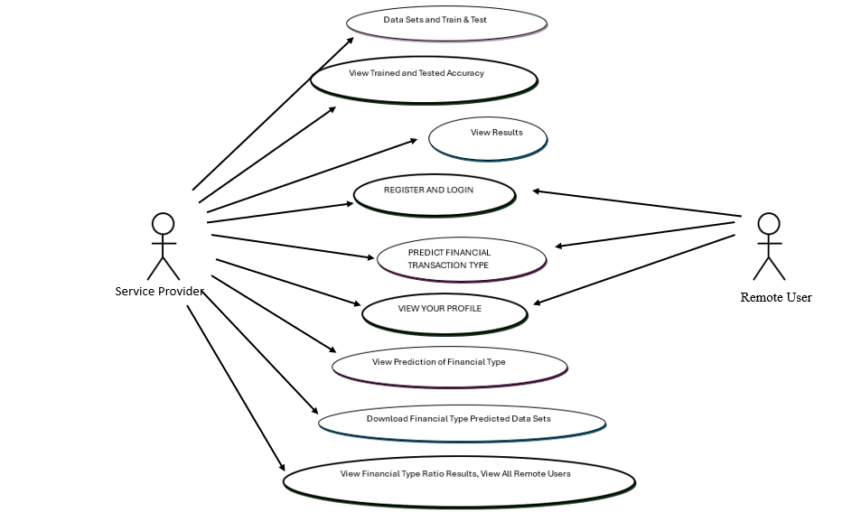
UML DIAGRAMS
USE CASE DIAGRAM

Slide 14
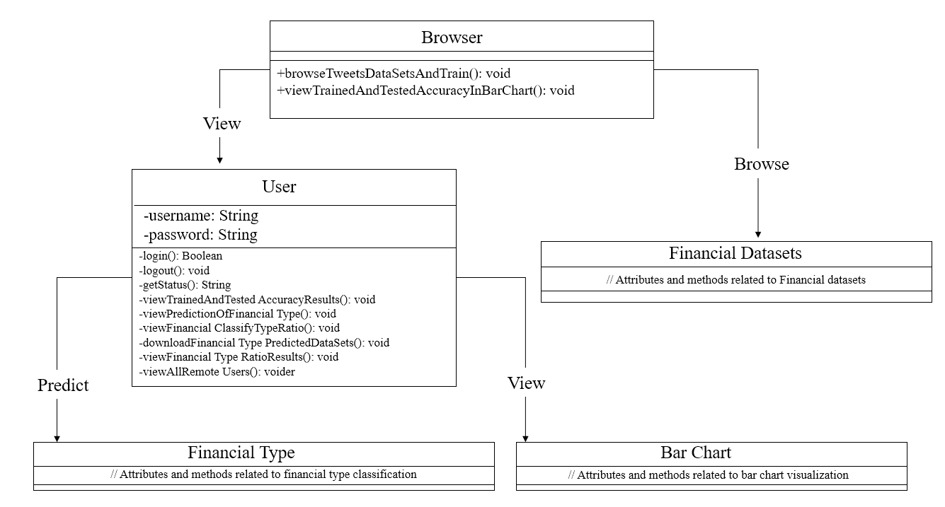
CLASS DIAGRAM

Slide 15
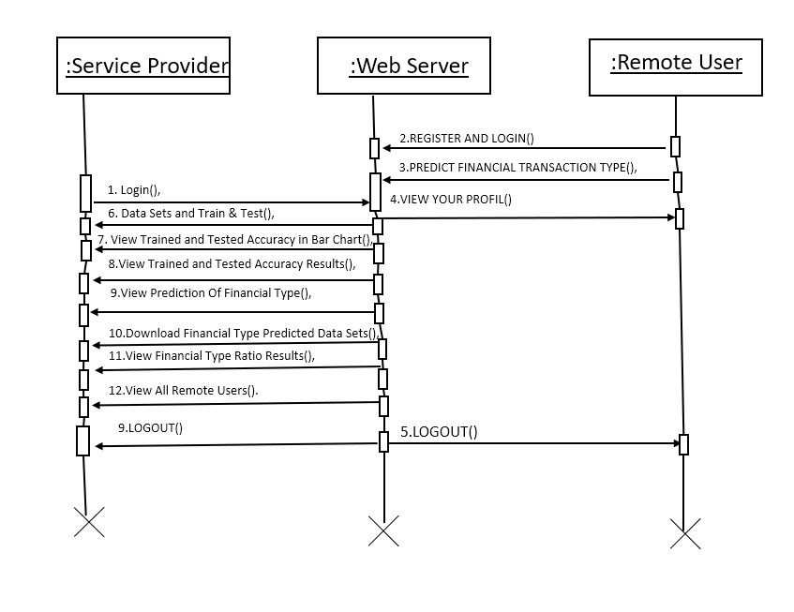
SEQUENCE DIAGRAM

Slide 16
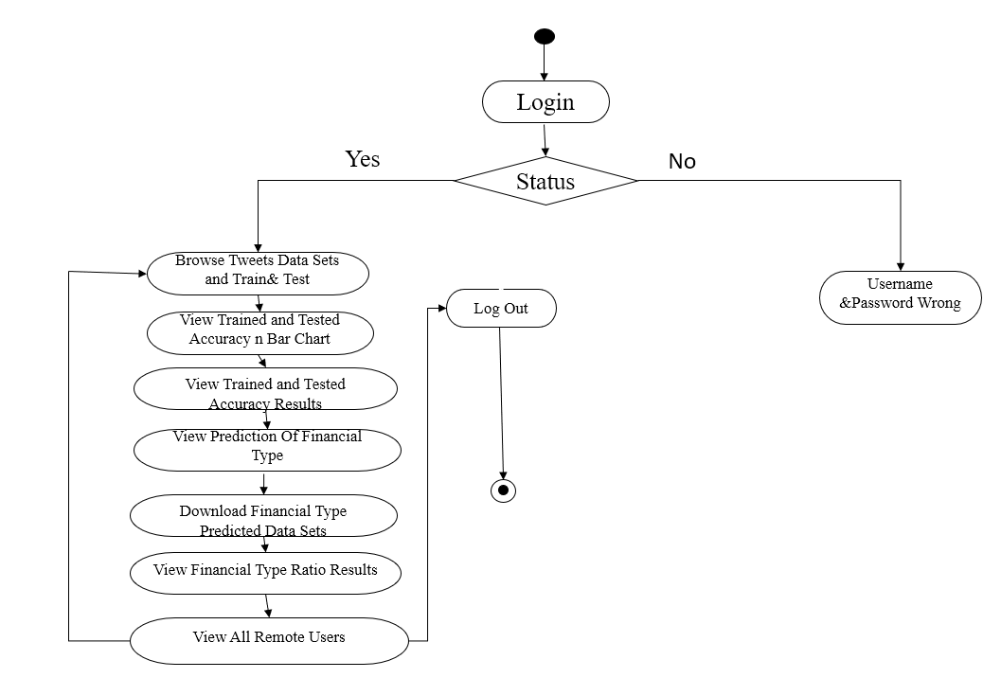
ACTIVITY DIAGRAM

Slide 17
SAMPLE CODE
from django.db.models import Count, Avg
from django.shortcuts import render, redirect
from django.db.models import Count
from django.db.models import Q
import datetime
import xlwt
from django.http import HttpResponse
import numpy as
#to data preprocessing
from sklearn.compose import ColumnTransformer
from sklearn.preprocessing import OneHotEncoder
# Create your views here.
from Remote_User.models import ClientRegister_Model,Financial_Fraud_Prediction,detection_ratio,detection_accuracy
def serviceproviderlogin(request):
if request.method == "POST":
admin = request.POST.get('username')
password = request.POST.get('password')
if admin == "Admin" and password =="Admin":
detection_accuracy.objects.all().delete()
return redirect('View_Remote_Users')
return render(request,'SProvider/serviceproviderlogin.html')

Slide 18
def View_Financial_Type_Ratio(request): detection_ratio.objects.all().delete() rratio = "" kword = 'Fraud' print(kword) obj = Financial_Fraud_Prediction.objects.all().filter(Q(Prediction=kword)) obj1 = Financial_Fraud_Prediction.objects.all() count = obj.count(); count1 = obj1.count(); ratio = (count / count1) * 100 if ratio != 0: detection_ratio.objects.create(names=kword, ratio=ratio) ratio1 = "" kword1 = 'No Fraud' print(kword1) obj1 = Financial_Fraud_Prediction.objects.all().filter(Q(Prediction=kword1)) obj11 = Financial_Fraud_Prediction.objects.all() count1 = obj1.count(); count11 = obj11.count(); ratio1 = (count1 / count11) * 100 if ratio1 != 0: detection_ratio.objects.create(names=kword1, ratio=ratio1) obj = detection_ratio.objects.all() return render(request, 'SProvider/View_Financial_Type_Ratio.html', {'objs': obj})

Slide 19
# SVM Model
print("SVM")
from sklearn import svm
lin_clf = svm.LinearSVC()
lin_clf.fit(X_train, y_train)
predict_svm = lin_clf.predict(X_test)
svm_acc = accuracy_score(y_test, predict_svm) * 100
print("ACCURACY")
print(svm_acc)
print("CLASSIFICATION REPORT")
print(classification_report(y_test, predict_svm))
print("CONFUSION MATRIX")
print(confusion_matrix(y_test, predict_svm))
detection_accuracy.objects.create(names="SVM", ratio=svm_acc) print("Decision Tree Classifier")
dtc = DecisionTreeClassifier()
dtc.fit(X_train, y_train)
dtcpredict = dtc.predict(X_test)
print("ACCURACY")
print(accuracy_score(y_test, dtcpredict) * 100)
print("CLASSIFICATION REPORT")
print(classification_report(y_test, dtcpredict))
print("CONFUSION MATRIX")
print(confusion_matrix(y_test, dtcpredict))
detection_accuracy.objects.create(names="Decision Tree Classifier", ratio=accuracy_score(y_test, dtcpredict) * 100)

Slide 20
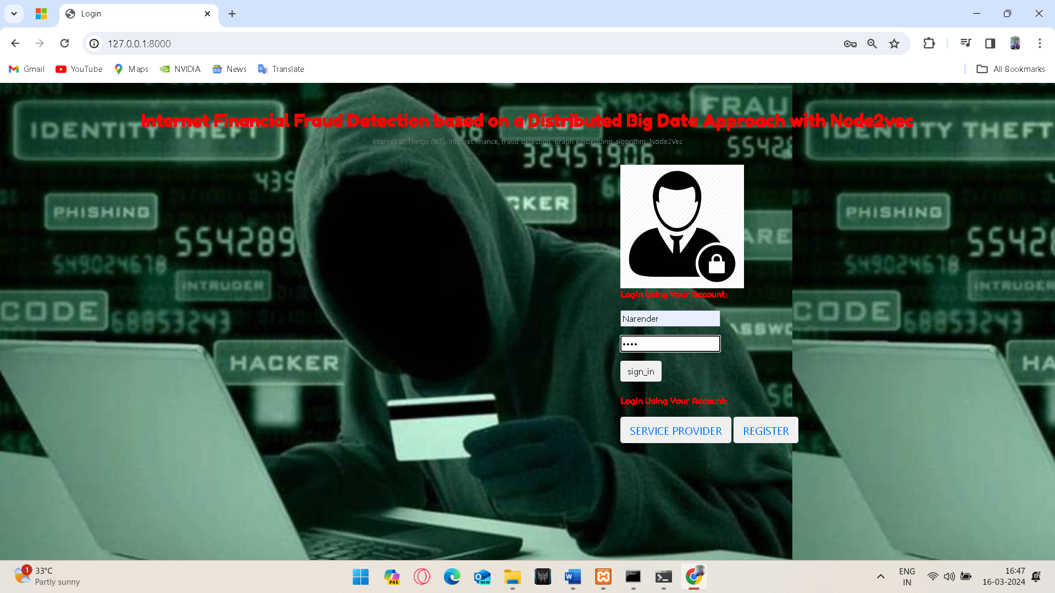
RESULTS
Home Page

Slide 21
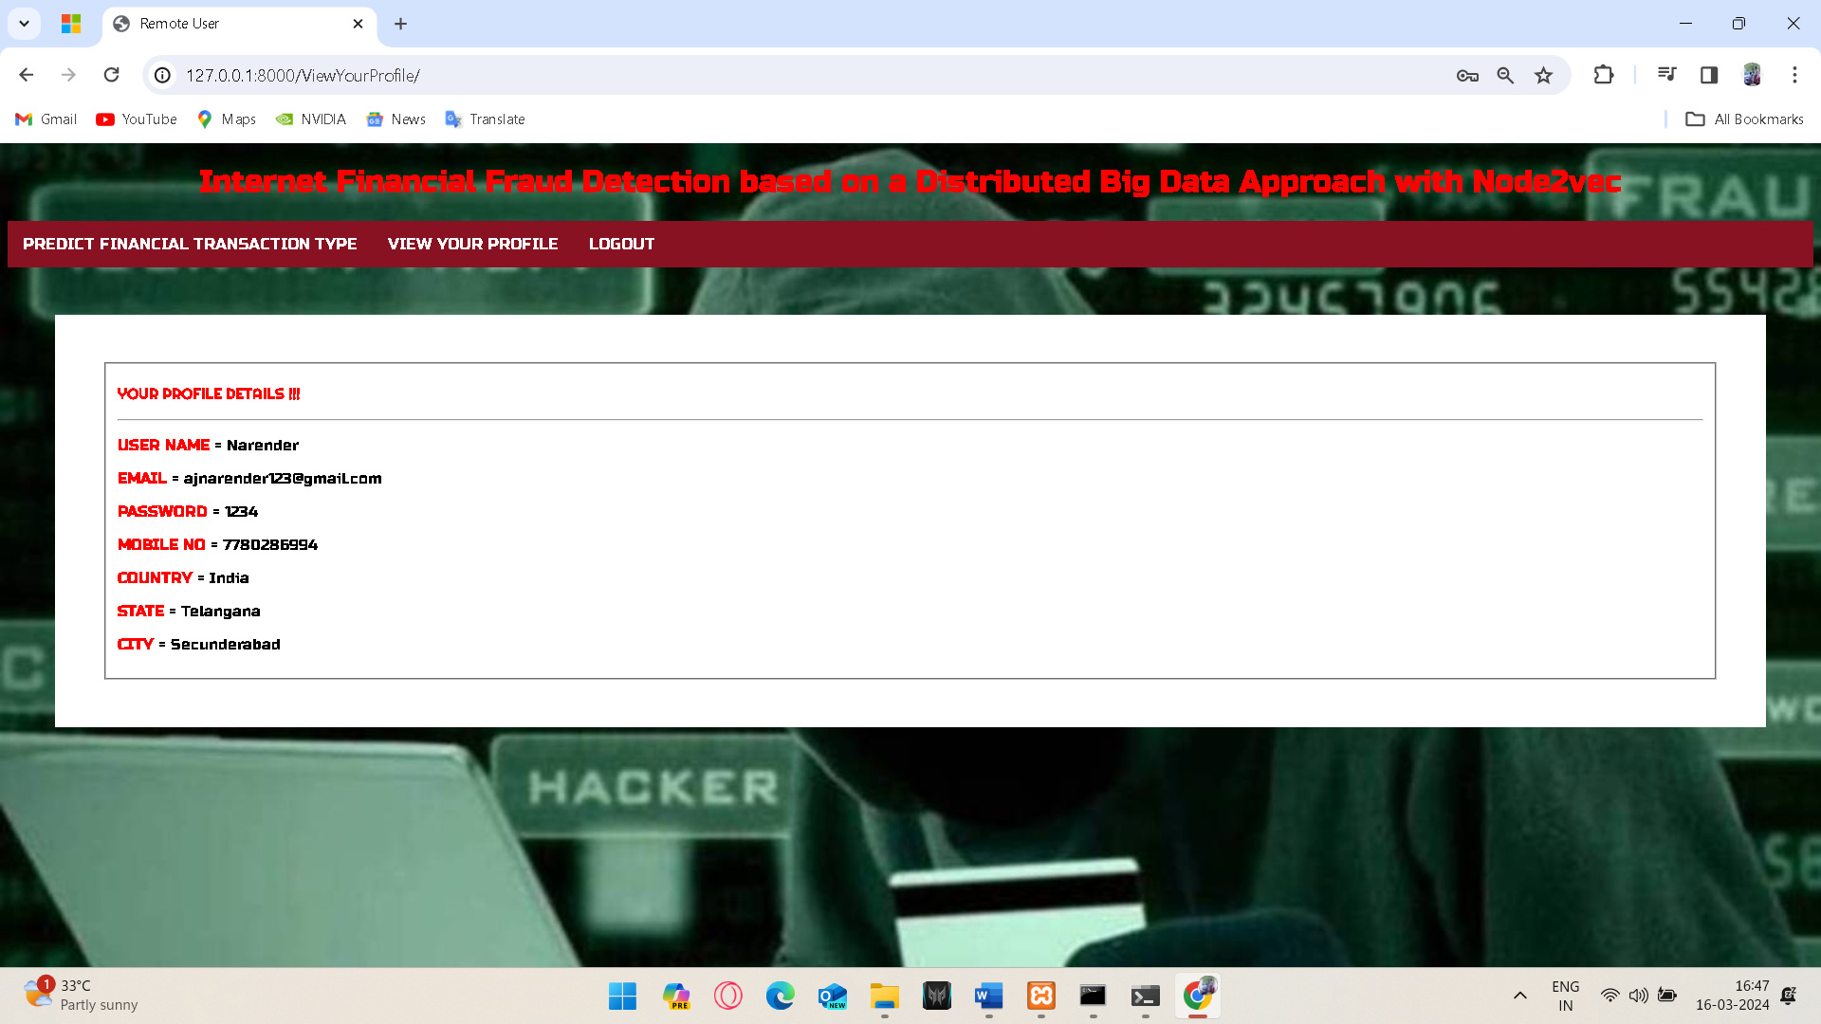
Your Profile Details

Slide 22
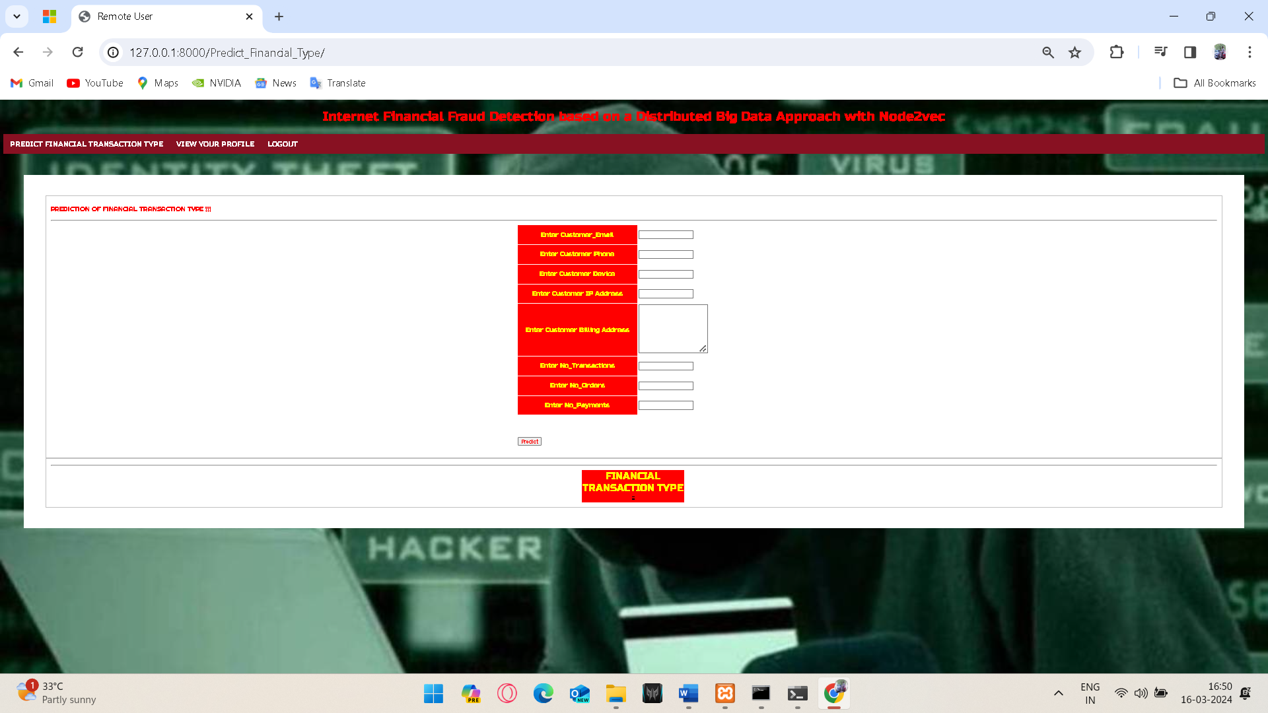
Predicting Financial Transaction Types

Slide 23
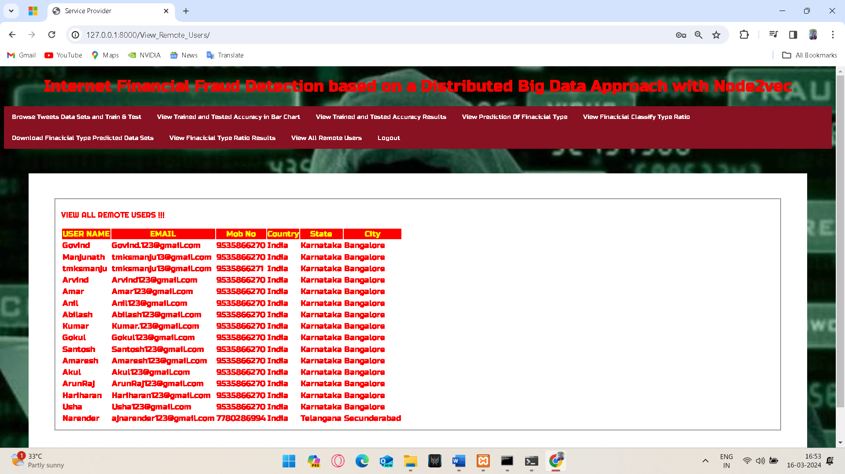
Datasets Consist Of Browse Tweets From Remote Users, And They Are Utilized For Both Training And Testing Purposes

Slide 24
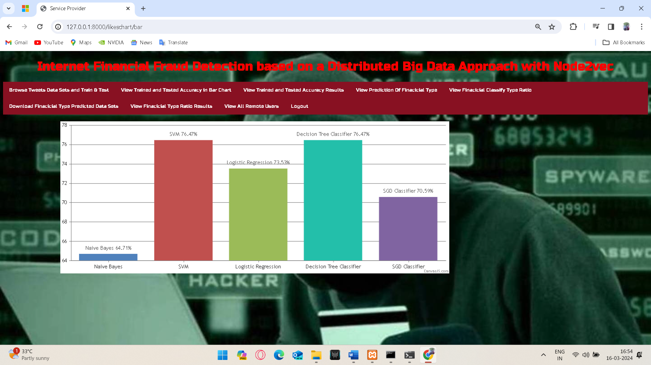
Comparison Graph Based On Accuracies

Slide 25
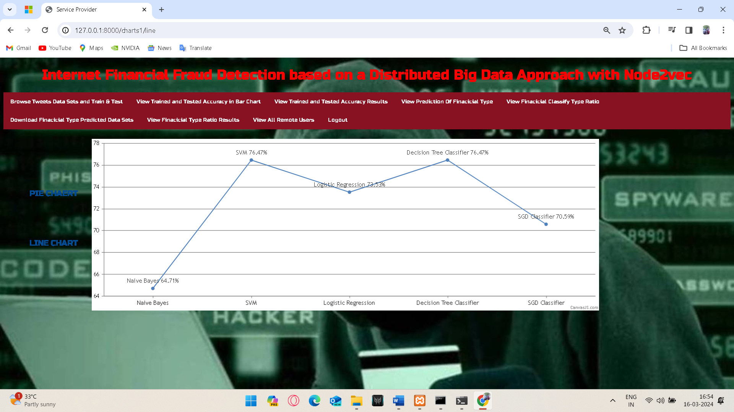
Trained And Tested Accuracy Results Of Various Algorithms Representing In Pie Chart And Line Chart.

Slide 26
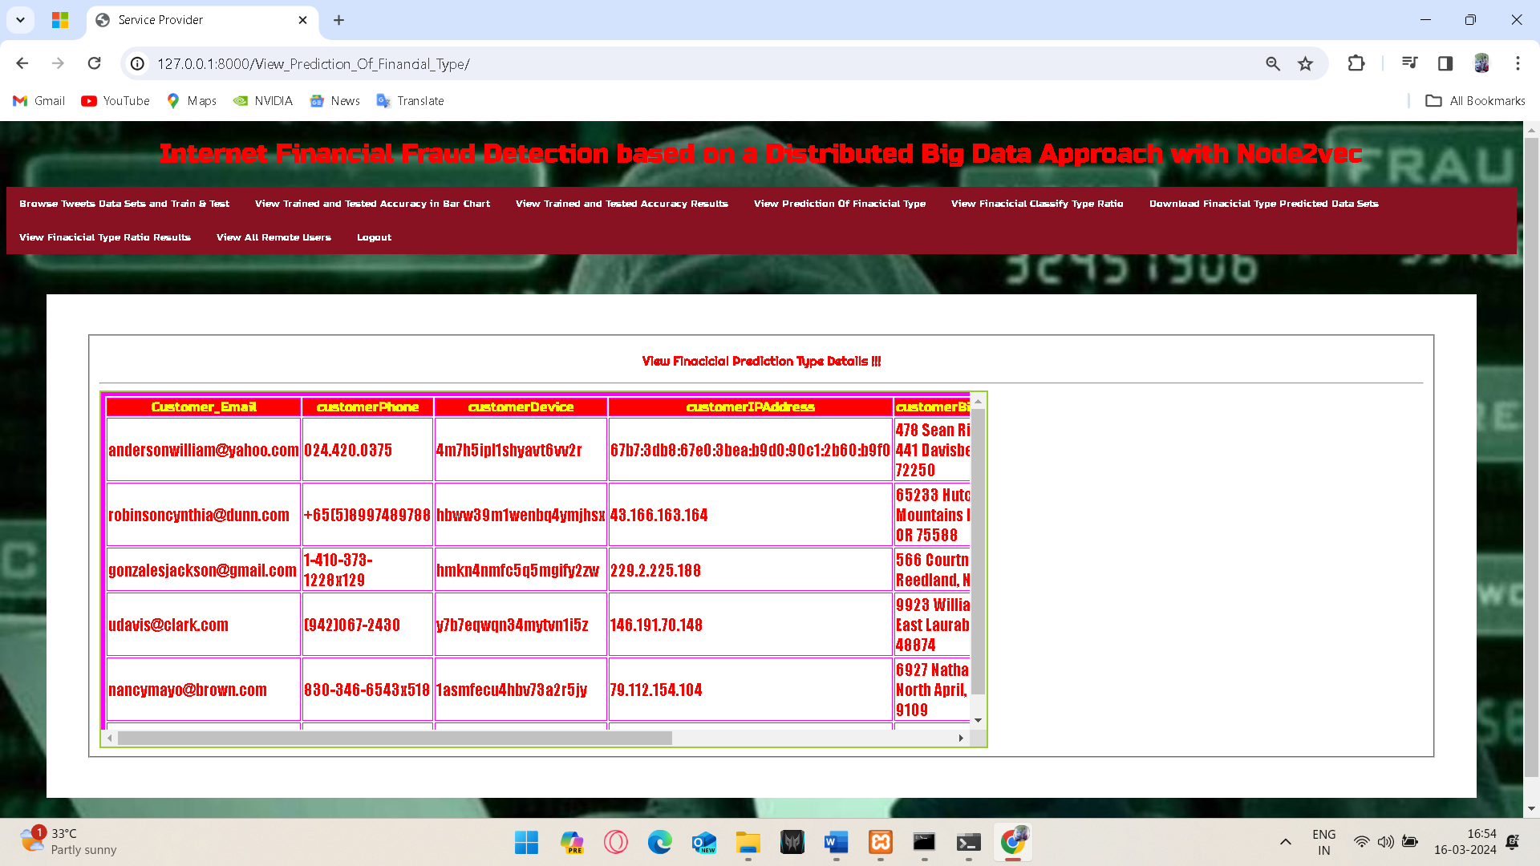
Prediction Of Financial Type Whether The User Have Done Any Fraud Or Not

Slide 27
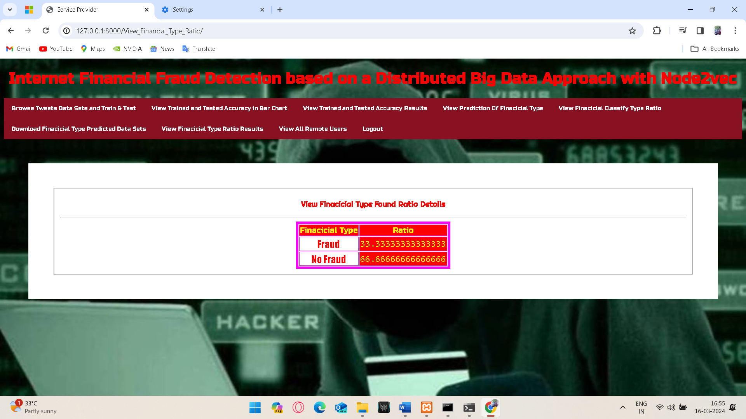
Financial Classify Type Ratio

Slide 28
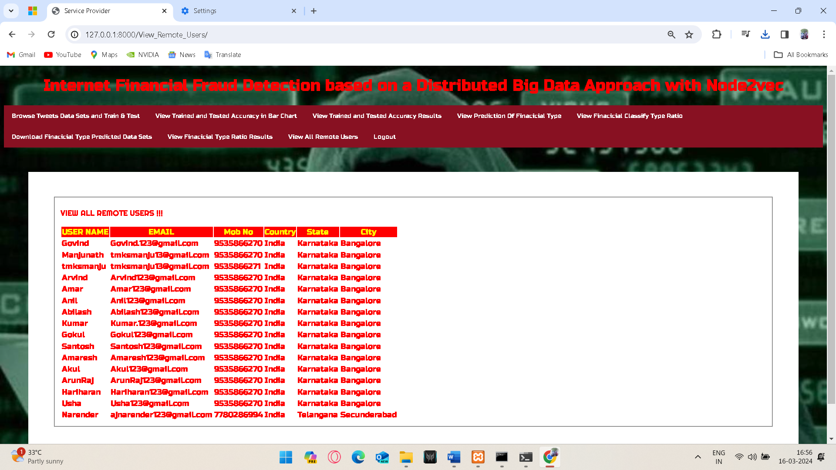
View All Remote Users

Slide 29

CONCLUSION
The occurrences of Internet financial fraud cases have caused huge losses to commercial banks or financial institutions. To enhance the efficiency of financial fraud detections, an intelligent and distributed Big Data approach is proposed in this article. The graph embedding algorithm Node2Vec is implemented on Spark GraphX and Hadoop to learn and represent the topological features of each vertex in the network graph into a low- dimensional dense vector, to improve the classification effectiveness of deep neural network and predict the fraudulent samples of the dataset.

Slide 30

FUTURE SCOPE
In the future, the "Internet Financial Fraud Detection based on a Distributed Big Data Approach with Node2vec" project holds significant potential for further development. This includes improving the accuracy of fraud detection models, exploring advanced graph analytics techniques like Graph Neural Networks, and implementing real-time fraud prevention mechanisms. Continued focus on regulatory compliance, user education, and ethical AI practices will be essential. By embracing innovation and staying responsive to evolving fraud threats, the project can continue to enhance online financial security and contribute to a safer digital economy.

Slide 31
REFERENCES
A. Srivastava, A. Kundu, and S. Sural, “Credit card fraud detection using hidden Markov model,” IEEE Transactions on Dependable and Secure Computing, vol. 5, no. 1, pp. 37-48, 2008.
C. C. Aggarwal, Y. Zhao, and S. Y. Philip, “Outlier detection in graph streams,” in Proc. IEEE 27th International Conference on Data Engineering, 2011, pp. 399-409.
E. L. Paula, M. Ladeira, and R. N. Carvalho, “Deep learning anomaly detection as support fraud investigation in Brazilian exports and anti-money laundering,” in Proc. 15th IEEE International Conference on Machine Learning and Applications, pp. 954-960, 2016.
A. Grover and J. Leskovec, “Node2vec: scalable feature learning for networks,” in Proc. 22nd ACM SIGKDD International Conference on Knowledge Discovery and Data Mining, 2016, pp. 855-864.

Slide 32
THANK YOU

